Slide 1
YouTube Comment Analyzer

Slide 2
Definition
A YouTube Comment Analyzer is a system or tool that automatically collects, processes, and analyzes comments associated with YouTube videos. It utilizes various techniques, including natural language processing (NLP) and sentiment analysis, to derive insights into user sentiments, engagement, and topics discussed in the comments section.

Slide 3
Tools
Programming Language: Use a programming language such as Python for implementing the analyzer due to its extensive libraries and frameworks for data analysis.
IDE (Integrated Development Environment): Choose an IDE like Jupyter Notebook or Visual Studio Code for developing and testing your code.
Version Control: Utilize version control systems like Git to track changes and collaborate on the project.
Collaboration Tools: Use collaboration tools like GitHub for version control and project management.

Slide 4
Resources
YouTube Data API: [YouTube Data API Documentation]
NLP Libraries: SpaCy ([SpaCy Documentation]
Machine Learning Models: Scikit-learn ([Scikit-learn Documentation]
Visualization Tools: Matplotlib ([Matplotlib Documentation],Seaborn ([Seaborn Documentation],Plotly ([Plotly Documentation]
Kaggle : for dataset train and test our model.
Websites
Socialbee
Hootsuite
Brandwatch
https://commentanalyzer.com

Slide 5
Flow
1. Extract Data from YouTube :
Use the YouTube Data API to extract comments and related information from a specific video.
2. Data Preprocessing:
Tokenization: Breaking down comments into individual words or tokens.Removing stop words
Lemmatization: Reducing words to their base or root form.
3. Sentiment Analysis Model:
Train a sentiment analysis model using machine leargning techniques. You can use a pre-trained model or train one using labeled data. The goal is to classigfy comments into categories like positive,negative, or neutral based on sentiment.
4. Insights and Reporting:
Generate report summarizing the finding from the sentiment analysis. Provide positive negative and neutral comments

Slide 6
Software Requirements Speciﬁcation (SRS)
Comment Analyzer:
1. Introduction
1.1 Purpose
The purpose of this document is to deﬁne the
requirements for the development of the YouTube
Comment Analyzer, a specialized software application
tailored for analysing comments speciﬁcally on the
YouTube platform. The YouTube Comment Analyzer aims
to provide users with valuable insights into the
sentiment, relevance, and potential impact of
comments on YouTube videos.
1.2 Scope
The YouTube Comment Analyzer will focus exclusively
on processing and analysing text-based comments
posted on YouTube videos. The software will leverage
natural language processing (NLP) techniques to assess
the sentiment of comments, identify key topics, and
provide an overall evaluation of the comment's impact
within the YouTube context.
1.3 Deﬁnitions, Acronyms, and Abbreviations
NLP: Natural Language Processing
SRS: Software Requirements Speciﬁcation

Slide 7
API: Application Programming Interface
System Features:
YouTube Video Input: Users can input the URL of a
YouTube video to analyse the comments associated
with that video.
Comment Sentiment Analysis: The system will
determine the sentiment of each comment (positive,
negative, neutral) within the context of YouTube.
Topic Extraction for YouTube: Identify key topics and
themes within the comments speciﬁc to YouTube
content.
Relevance Assessment for YouTube: Evaluate the
relevance of comments to the YouTube video's content.
Functional Requirements:
• YouTube Video Input
1. Description:
Users should be able to input the URL of a
YouTube video for which they want to analyse
comments.
2. Inputs
YouTube video URL
3. Outputs
Processed comments associated with the
provided YouTube video ready for analysis.
• Comment Sentiment Analysis
1.Description:

Slide 8
The system should analyse the sentiment of
each comment related to a YouTube video and
categorize it as positive, negative, or neutral,
considering the YouTube-speciﬁc context.
Non-functional Requirements:
• Performance:
1. Response Time
The system should provide responses to user
queries within 3 seconds for optimal user
experience.
2. Scalability
The system should be scalable to handle a
minimum of 10,000 comments per YouTube video.
• Reliability
1. Availability
The YouTube Comment Analyzer should be
available 99.9% of the time during standard
operating hours.
2. Error Handling
The system should provide clear and user-friendly
error messages for any issues encountered during
the analysis process.
• Usability:
1. User Interface
The user interface should be intuitive and user-
friendly, requiring minimal training for users to
navigate and utilize the features.
2. Accessibility

Slide 9
The system should adhere to accessibility
standards to ensure that users with disabilities can
use the Comment Analyzer eﬀectively.
• Compatibility:
1. Browser Compatibility:
The Comment Analyzer should be compatible with
major web browsers such as Chrome, Firefox, and
Safari.
2. YouTube API Compatibility:
The system should be compatible with the latest
version of the YouTube API to ensure accurate and
up-to-date comment retrieval.

Slide 10
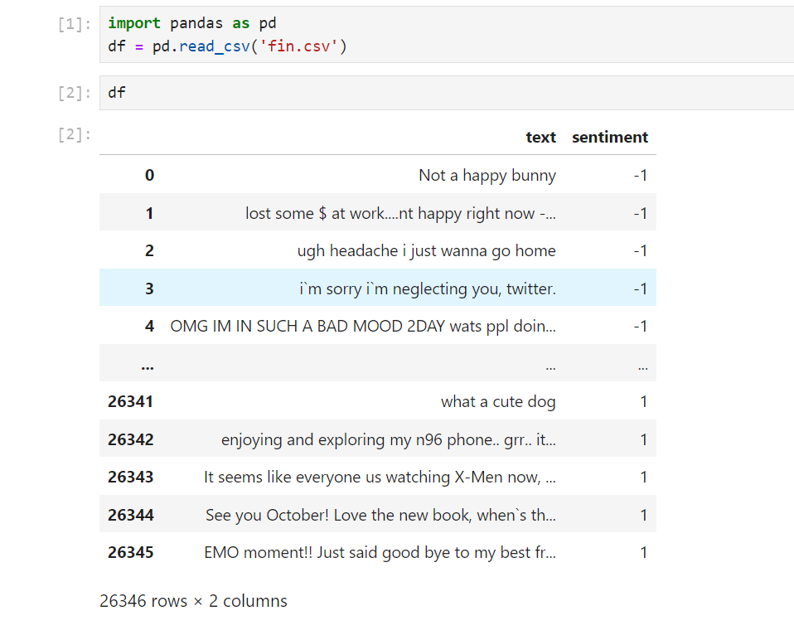
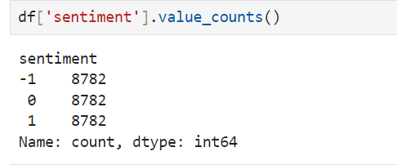

Slide 12
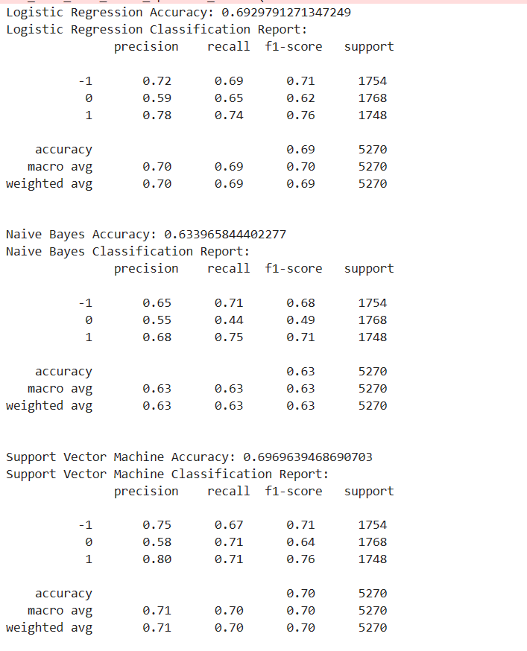
Train_model with TFIDF

Slide 13
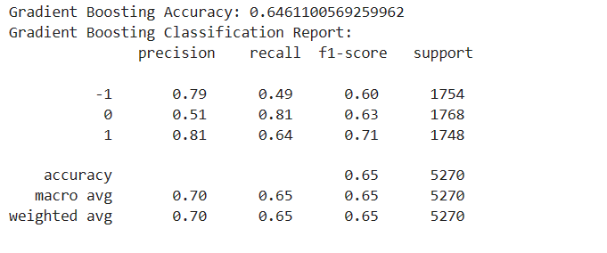

Slide 14
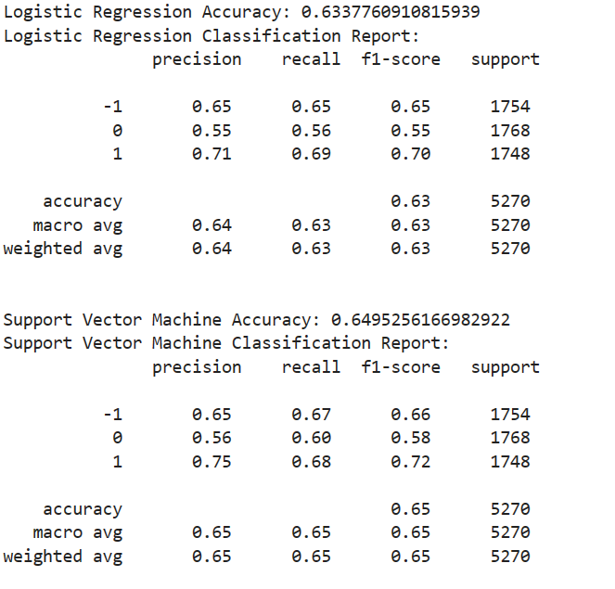
Train_model with Word Embedding

Slide 15
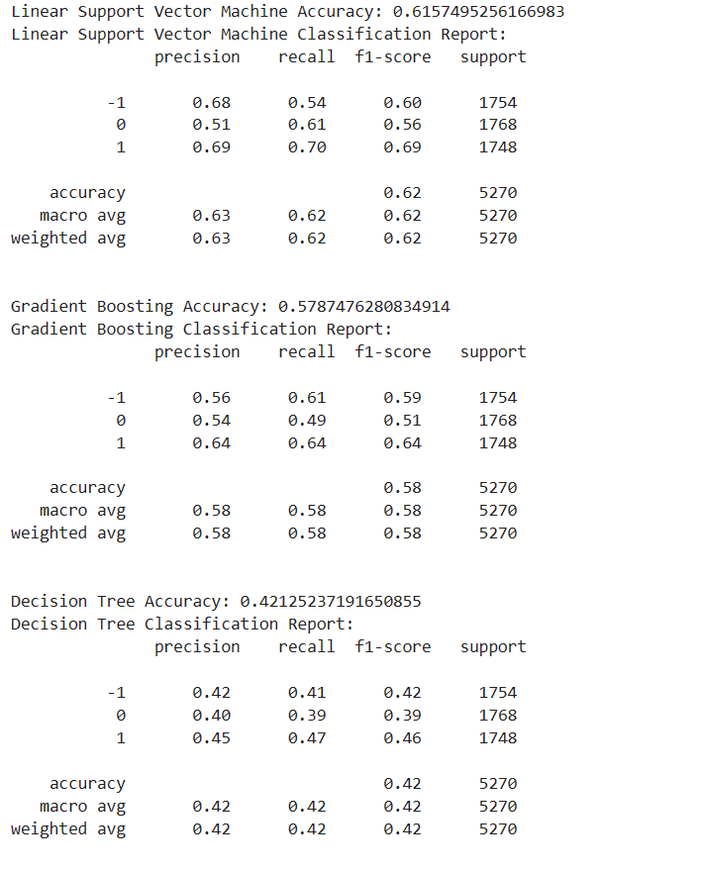

Slide 16
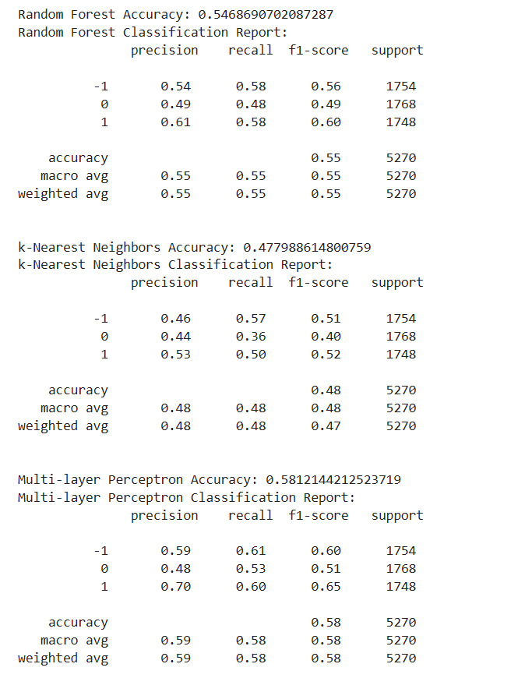

Slide 17
